Slide 1




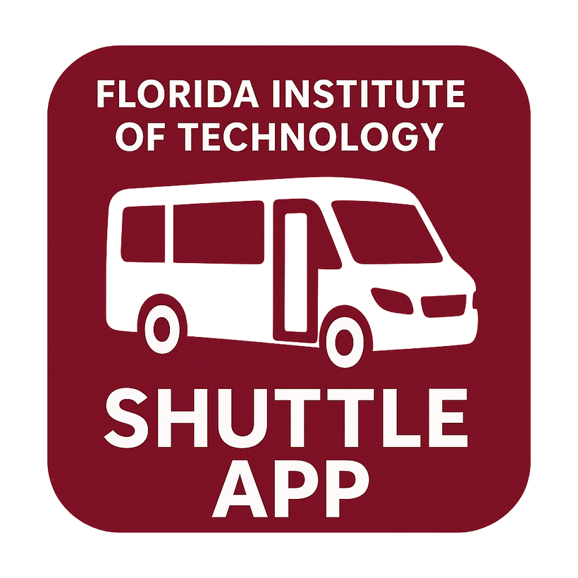

PANTHER SHUTTLE APP
www.OurWebsite.com
Members: Joseph Hilte, Tony Arrington, Jonathan Suo, and Chase Monigle

Slide 2



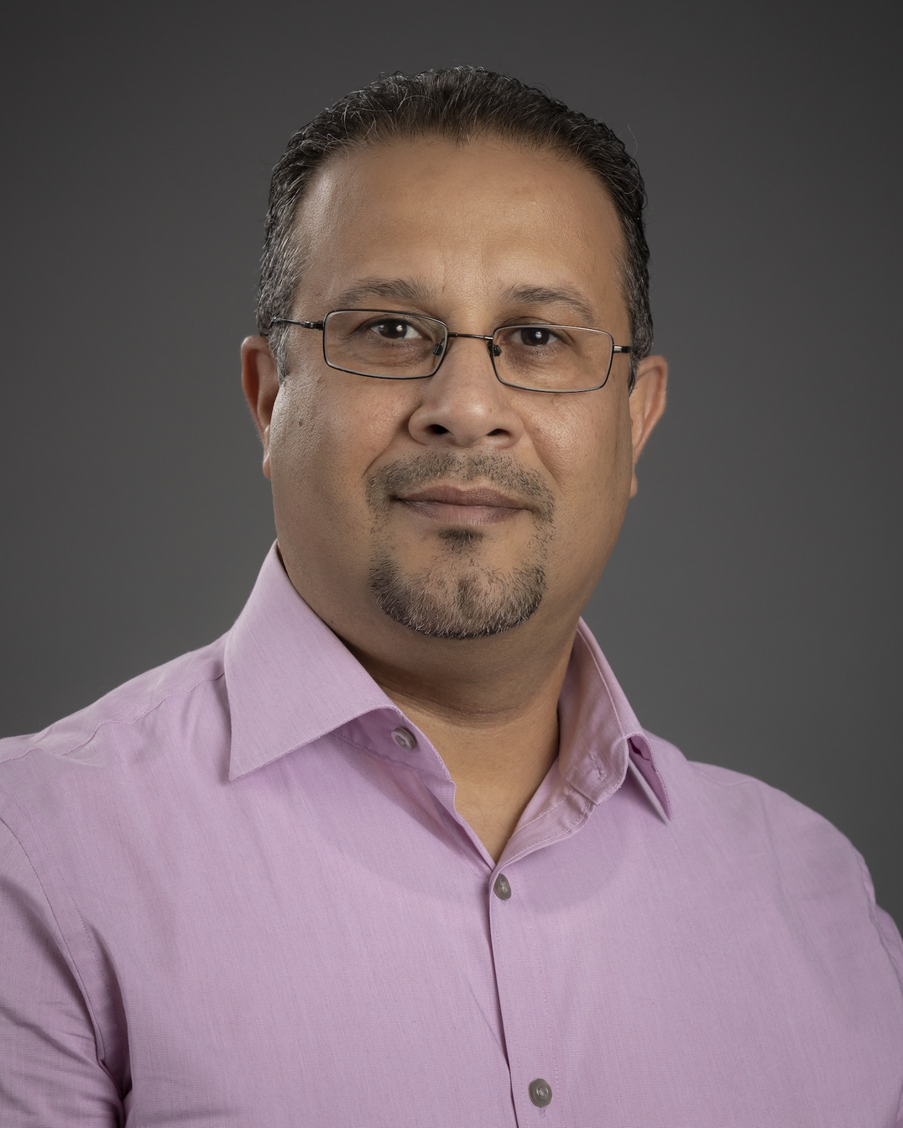





Who is involved?
Faculty Advisor: Professor Khaled Ali Slhoub
Serving as the academic mentor for this project, providing guidance on methodology, research direction, and overall academic rigor.
Client: Professor Vincent Borrelli
Acting as the project user/tester, offering domain expertise, and ensuring that the outcome align with the client’s needs.
Client #2: TBD (Working with Shuttle Services)

Slide 3




Technical/Collaboration Tools
Main Technical Tool
Android Studio – The primary development environment used to design, code, test, and deploy the shuttle tracking app. It provides powerful tools for building Android applications with seamless integration of real-time features.
Collaboration Tools
GitHub – Used for version control, collaborative coding, and tracking project progress through branches, commits, and issues.
Google Calendar – Helps the team coordinate deadlines, meetings, and milestones to stay organized and on schedule.
Google Drive – Centralized storage for documents, presentations, and shared resources, ensuring easy access and collaboration.
Discord – Serves as the main communication hub for the team, enabling instant messaging, voice channels, and quick discussions.

Slide 4



Main Features Outlined
Made clear specification of the core functions of the shuttle tracking app, including real-time tracking, notifications, and route accessibility.
GUI Mockups
Project Deliverables
Created visual designs of the app interface to demonstrate layout, usability, and overall user experience before development.
UML/Class Diagrams
Created structured diagrams that map out the system architecture, object relationships, and data flow for maintainability and clarity.
Test Cases / Testing Methods
Created sets of planned scenarios and techniques to ensure the app functions correctly, reliably, and meets user requirements.

Slide 5
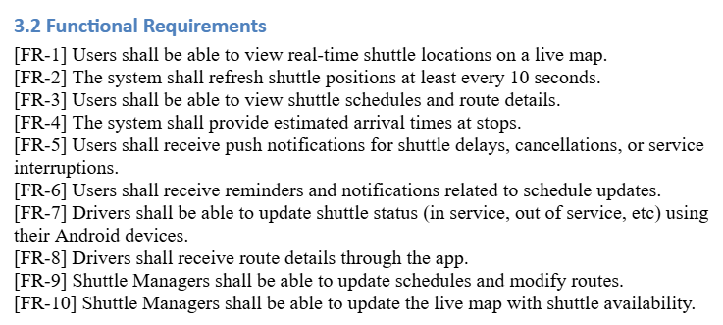

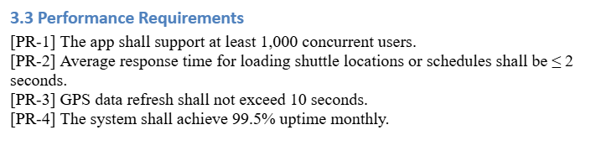
Requirements Examples

Slide 6

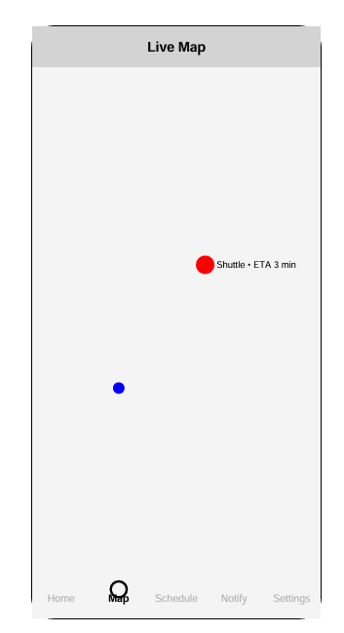
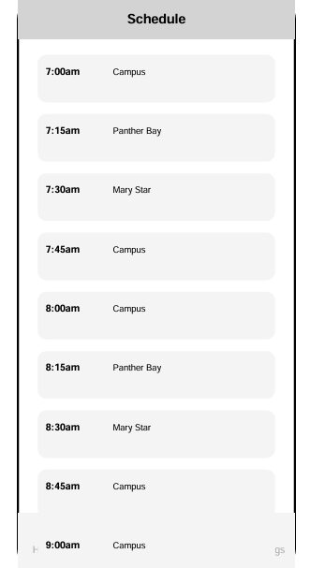
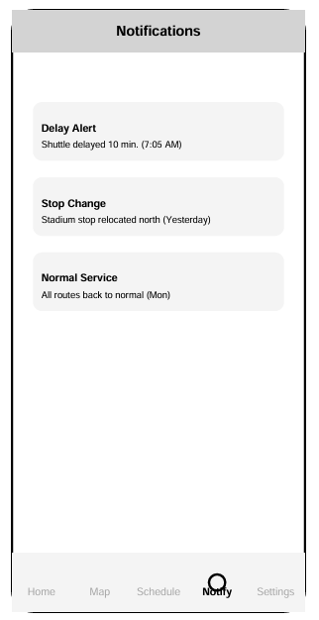
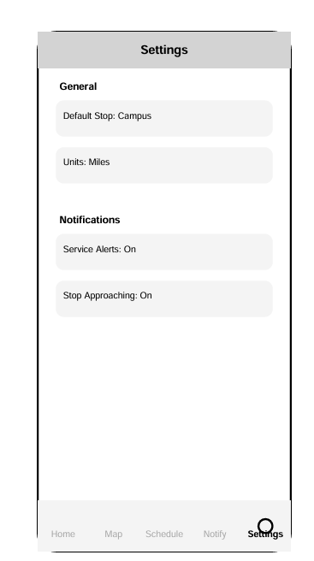
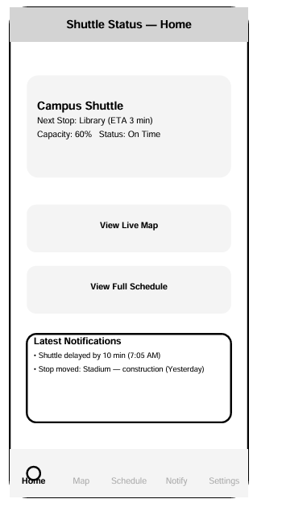
Design Mockups

Slide 7
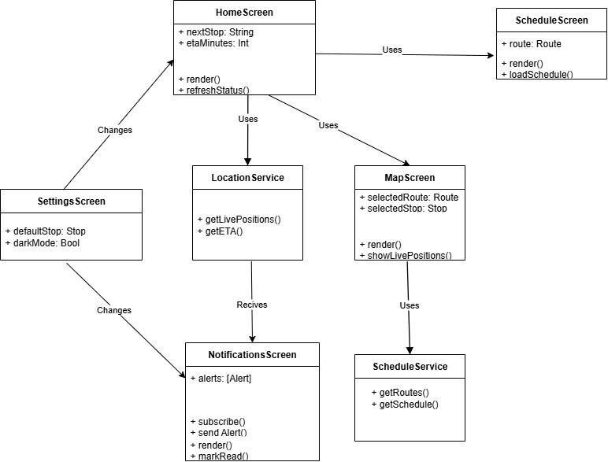
UML Diagram

Slide 8
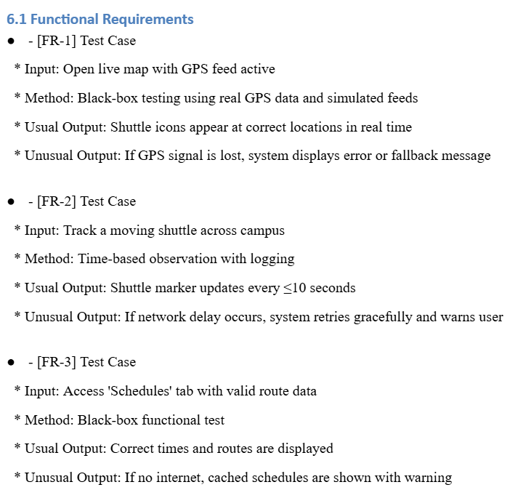
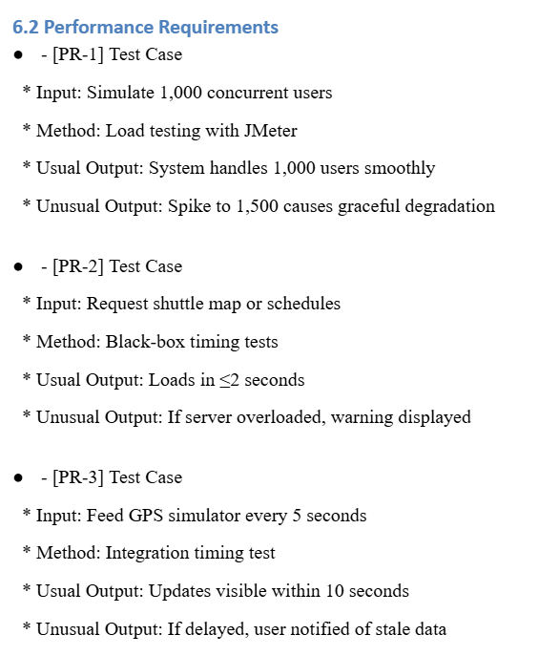



Test Plan Examples

Slide 9





Challenges
Learning Curve
Accurate Tracking
Shuttle Service Integration
Adapting to new development tools and frameworks such as Android Studio and ensuring we gain the necessary technical proficiency.
Implementing reliable GPS and real-time data updates while handling issues like connectivity loss, latency, or signal interference.
Coordinating with campus shuttle operations, schedules, and possible route changes to ensure the app reflects real-world conditions.

Slide 10
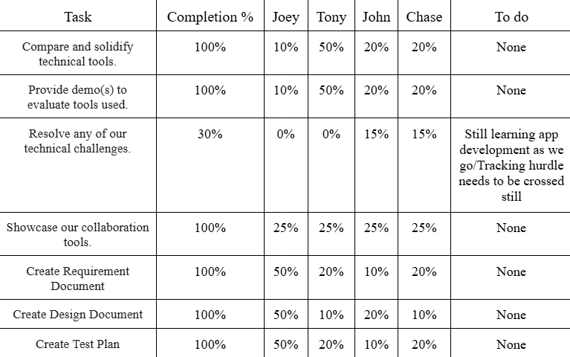

Milestone #1 Progress

Slide 11
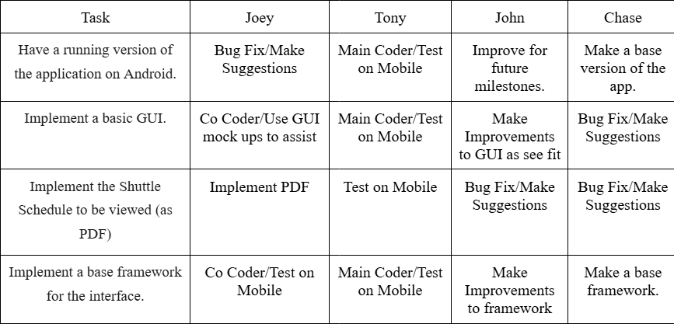
Milestone #2 Plan

Slide 12





QUESTIONS?
Visit our website
www.Our site.com

